Slide 1
Application of ND CRC to be a member of the OSG Council Jarek Nabrzyski CRC Director naber@nd.edu

Slide 2
About me
1995-2008 – Poznan Supercomputing and Networking Center, Poland
Co-founder of eGrid (European Grid Forum)
Co-founder of GGF
2008-2009 – CCT@LSU – Executive Director
2009-today – CRC@ND
First incoming director of the CRC
Faculty in the CSE department
Research – Resource management, workflow scheduling, cloud computing
Teaching – Cloud Computing

Slide 3
Why I am here?
Notre Dame is becoming more and more involved in national and international large-scale scientific collaboration
CMS
Data preservation
Malaria, and other infectious diseases
Adaptation to climate change, and more…
Need for national collaborations from apps to infrastructure layers
OSG’s has always been perceived by the CRC as one of the most important national production DCEs

Slide 4
Why am I here (2)
Strong belief that together we can do much more
High value of OSG’s goals
Be a good citizen
Contribute spare resources to a national production infrastructure
Contribute to the national cyberinfrastructure vision
This is a long term commitment!

Slide 5
CRC Mission
The University of Notre Dame’s Center for Research Computing (CRC) engages in computational science, fosters multidisciplinary research and provides advanced computational tools and services. The CRC works to facilitate discoveries across science, engineering, arts, humanities, social sciences, business and other disciplines.

Slide 6
CRC Vision
To become an internationally recognized multidisciplinary research computing center based upon our reputation for facilitating and accelerating discovery through effective and novel applications of cyberinfrastructure.

Slide 7
CRC Goals
Research: To help Notre Dame be among the world’s leaders in conducting multidisciplinary research through the application of cyberinfrastructure.
Infrastructure: To provide reliable advanced computational architectures, software solutions and multidisciplinary collaborative lab spaces.
Service and Education: To develop a customer service strategy, improving support for current CRC customers while attracting new customers.
Economic Development: To facilitate technology transfer and accelerate innovation.

Slide 8
Organization Chart
8 staff members
25 staff members

Slide 9
CRC in Numbers
~$1.5M in re-charge projects per year
PI/co-PIs on grants
$50M total value
$12.9M annual research expenditures
65 publications co-authored by CRC computational scientists over last three years
1350+ users (350 faculty, 700 grad students)
100+ CI projects of various size supported over last two years
20,000 computing cores managed by the CRC
4x more computational resources (since I joined ND)
5x more users (since I joined ND)

Slide 10
User Growth Number of Active Accounts By Request
More Computationally Based Faculty
Better Outreach
More Capable Facilities
Migration of Computational Faculty
Notes:
Nabrzyski joins in May 2009, and already in December we observe faster growth
Since 2011 the user base is saturated, but we still bring new active accounts every year (especially social science, biology)
Every year around 25% users are replaced with new incoming users (mostly grad and undergrad students)

Slide 12
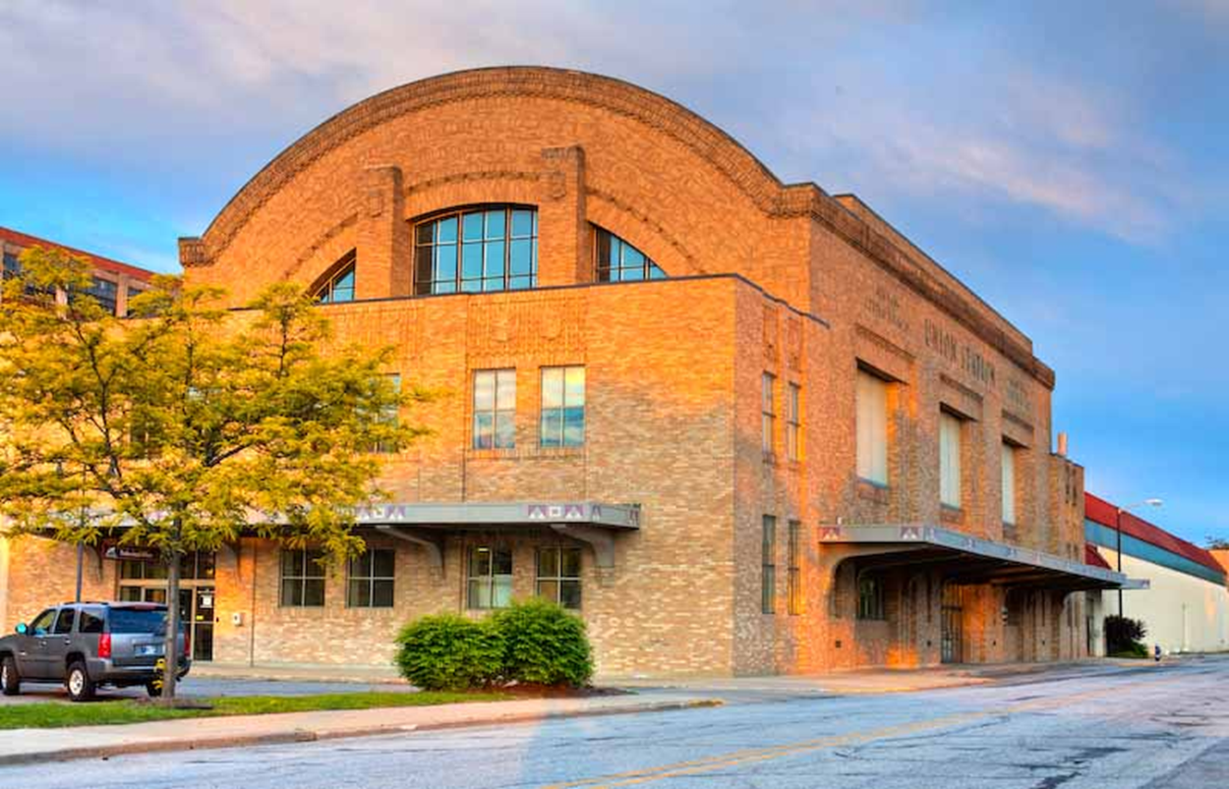
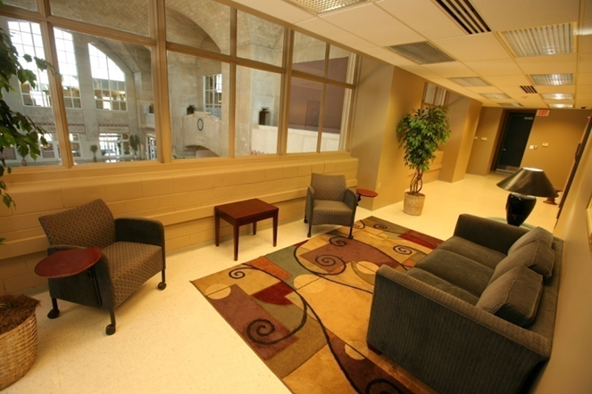
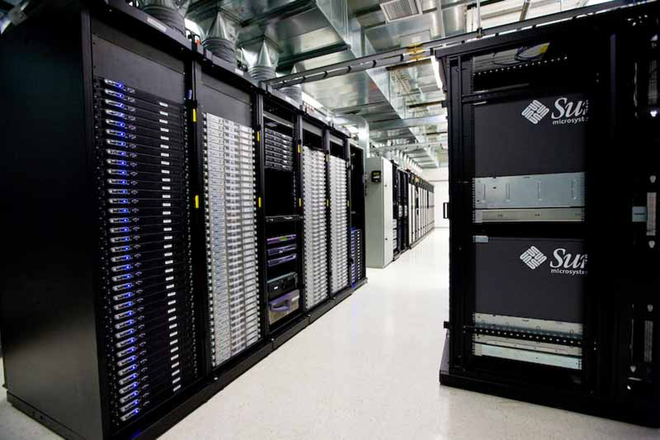
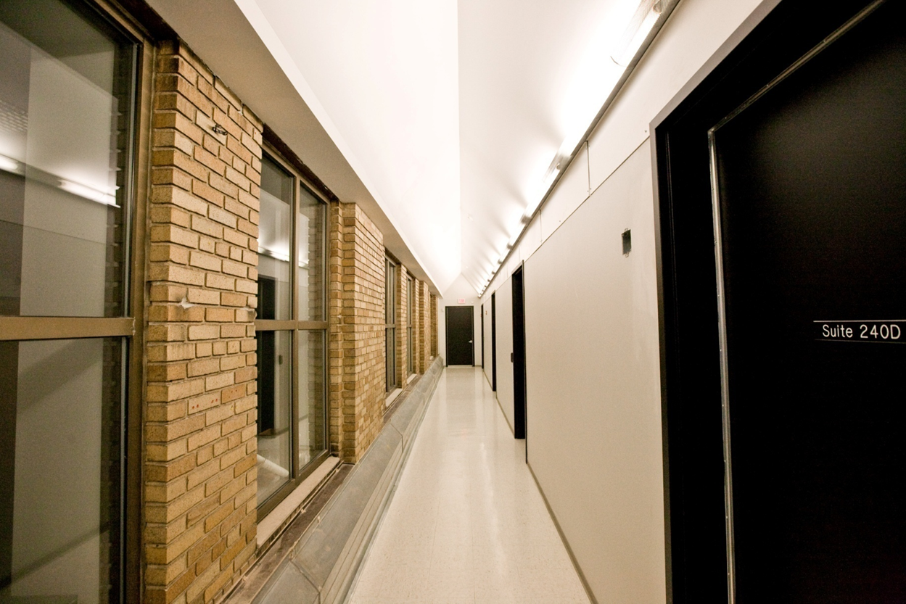
Equipment Facilities
ND CRC Data Center
Located at Union Station
1700 sqft machine room
650 sqft office
4 offices
1 hotel station
> 1,600 servers
20,000 Cores

Slide 13
ND CRC application groups
Molecular dynamics groups, Folding@home
Chemical engineering and chemistry
Civil engineering (storm surge, winds and high buildings, hurricane center)
AME (flow problems, gas turbines)
Biology (genomics, infectious diseases, ecology, climate change)
Social sciences
Biology and social sciences are growing fast!

Slide 14
ND Collaboration examples
VecNet and MTC projects
Gates Foundation malaria projects
Malaria transmission and intervention: data, models and simulations
International collaboration involving UK, Greece, Australia, Mexico, Switzerland
CyberEye – hurricane preparedness center
ND CMS and physics groups
Support the CMS infrastructure
Data preservation for HEP (DASPOS - NSF Grant)
QuarkNet (NSF) program
Folding@Home - research and infrastructure with Stanford
200,000 computers around the world

Slide 15
NDCMS
EARTH
Functionality:
Backend server
Condor central manger
Condor submit host
Users do not login
NFS serves locations:
DAS array – /store
Condor software
Name Node for Hadoop
Software:
RHEL Server 5.8
CE/SE OSG 3.1.12
Condor 7.8.7
Hardware:
Dell PowerEdge R815
CPUs - 4x8 cores
RAM – 64GB
Functionality:
User interactive host
Condor submit host
CE/SE OSG 3.1.12
CMS Software Stack:
Access to CMSSW/CRAB/gLite
PhEDEx via panFS
Software:
RHEL Server 5.8
CE/SE OSG 3.1.12
Condor 7.8.7
Hardware:
Dell PowerEdge R815
CPUs - 4x8 cores
RAM – 128GB
/store
Direct Attached Storage
Capacity – 80TB (raided)
Connectios:
FC direct to NDCMS
EARTH and WN via NFS
/pscratch
r22bd8810
Panasas Storage
Capacity – 220TB (raided)
CMSSW/CRAB/gLite/PhEDEx resides here
Access to CMS Software from NDCMS/EARTH/WN via panFS protocol.
Enterprise Level Switch
BlackDiamond 8810
Panasas – 7 x 10Gb FC
EARTH – 10Gb FC
NDCMS – 10Gb FC
Stack Switches – 1Gb TP
Stack Switches Extreme Summit x460
switch
Cisco Router
72 hosts – condor work nodes
HP Proliant DL165 G6
CPUs – 2x6 cores
RAM – 12GB
RHEL Server 5.7
5 servers have 3x2TB disks, organized in the hadoop cluster with NDCMS as name node.
Replication factor - 3
Work Nodes
15x2TB Local HDDs
Internet
Notes:
2 Dedicated head nodes (1 for OSG/Condor/CMS services, 1 for interactive user processes)
72 compute nodes (12 cores and 12GB of RAM each: 864 cores total)
100TB NFS mounted filesystem (HP RAID Array)
60TB (RAW) Hadoop Storage
1Gb compute node connectivity, 10Gb head node connectivity, 10Gb external campus connectivity
Some files in AFS and Panasas filesystems for legacy reasons
Primary software stack components/communities: HTCondor, OSG, CMS

Slide 16
Summary
CRC is at the forefront of Notre Dame’s expanding research efforts
Growing demand for CRC infrastructure and services, both CI and HPC
Great opportunities still out there!
Reach out to remaining ND departments
National Cyberinfrastructure, capitalize on existing collaborations and build new
International collaboration

Slide 17
Questions?
I welcome your questions and engagement to help you decide on my application

